Slide 1
Nanaimo Circuit and VFR TERMINAL PROCEDURES

Slide 2
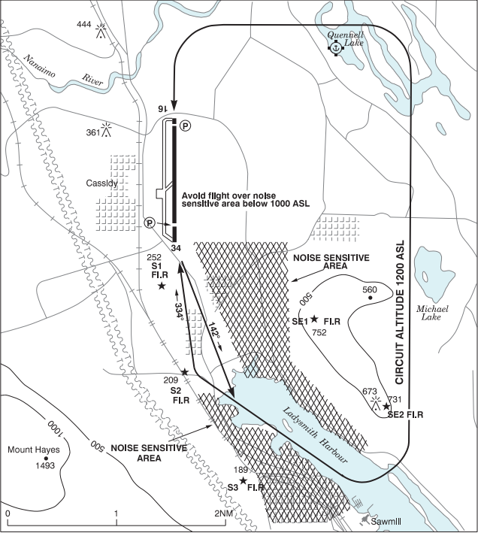
Nanaimo Circuit
IRREGULAR SHAPE, ALTITUDE 1200ASL
BOTH RWY 16 & 34 CCT ARE ON EAST SIDE OF AD, DUE TO TERRAIN TO THE WEST
3 NM WIDE CCT, USE QUENNELL AND MICHAEL LAKES AS A GUIDE
CBQ9 WATER AERODROME IN NE CORNER OF CYCD CIRCUIT
RWY 34 HAS A SLANT BASE AND FINAL LEG
RWY 16 VFR DEPARTURE HEADING 142
SEVERAL NOISE SENSITIVE AND BUILT UP AREAS
WOODLEY RANGE INSIDE SE QUADRANT OF CCT WITH HEIGHTS OVER 700 FT
5 HAZARD BEACONS
Notes:
We felt it important to describe in detail the CCT and procedures as we have had many pilots advise they are unfamiliar with it.
Most IFRs will square off final at 1-3 NM, depending on size and performance capabilities
2 Hazard beacons on Woodley SE1 752FT, SE2 731 FT
3 Along W Shore Ladysmith Harbour

Slide 3
CBQ9 WATER AERODROME
IN NE CORNER OF CYCD CIRCUIT
ALL ARRIVALS AND DEPARTURES ARE NORTHWEST OR SOUTHEAST
CIRCUITS AND TRAINING ARE HIGHLY DISCOURAGED
CIRCUITS ARE TO THE WEST OF THE ALIGHTING AREA, 800 FT AND BLO
Notes:
As you can see the BQ9 CCT intersects crosswind/base leg and the downwind of the YCD CCT. Important to stay above or climb above 800 FT until past that point.

Slide 4
Rwy 16 vfr departure procedure
FLY HEADING 142 TO THE HEAD OF LADYSMITH HARBOUR
AIRCRAFT REMAINING IN THE CIRCUIT FOR RWY 16 FOLLOW STANDARD CIRCUIT PATTERN
AIRCRAFT DEPARTING SOUTH AND SOUTHEAST FOLLOW LADYSMITH HARBOUR AT 1000 FT OR BELOW UNTIL CLEAR CONTROL ZONE, DUE IFR TRAFFIC
IFR LADY2. DEPARTURE PATH
IFR CLIMB PROFILE, WITH CX LIMIT 3000 FT
VFR FLY 1000 BLO
IFR CLIMB FM 1000 – 2100 FT
Notes:
IFR aircraft departing RWY 16 typically fly LADY2 departure. The departure path is runway heading for 1.6 NM (click), followed by a left turn towards mouth of Ladysmith Harbour
(click)
The LADY2 SID requires a climb gradient of 500 FT/NM to 2100 ft with a CX limit 3000 ft.
With the close proximity and intersection of both departures paths having VFR aircraft maintain 1000 ft or below until clear of the control zone keeps them below the departing IFR aircraft and ensures safety for all.

Slide 5
Non standard Circuit
FOR ANY DEVIATIONS FROM THE PUBLISHED CIRCUIT OR PROCEDURES, PILOTS NEED TO ADVISE AND COORDINATE WITH FSS
Notes:
Can not stress strongly enough the importance of knowing your intentions prior to implementing them. We need to know your plans, also you need to continue with mandatory reporting in order for FSS to pass traffic and to maintain safety for all aircraft.

Slide 6
Non standard Circuit
FASTER THAN ESTABLISHED CCT
PASSES OVER NOISE SENSITIVE AREAS AND GOLF COURSE
CLOSE PROXIMITY HIGHEST CONTOURS OF WOODLEY RANGE
NOT EXPECTED BY FSS OR OTHER TRAFFIC
CUTS INSIDE OF ESTABLISHED CIRCUIT AIRCRAFT LEAVING LITTLE ROOM TO RESOLVE CONFLICTS
IMPACTS DEPARTURE SEQUENCE, CLEARANCES AND IFR FLOW TIMES
Notes:
Can not stress strongly enough the importance of knowing your intentions prior to implementing them. We need to know your plans, also you need to continue with mandatory reporting in order for FSS to pass traffic and to maintain safety for all aircraft.

Slide 7
Examples of Non standard circuits
ABBREVIATED CIRCUITS
CUTS OFF AIRCRAFT ESTABLISHED WITHIN THE CIRCUIT
CREATES UNSAFE TRAFFIC SCENARIOS
FEW OPTIONS FOR NEGATING CONFLICTS
Notes:
Example: Pilot departed RWY 34 for CCTS, did not coordinate an abbreviated CCT with FSS, (click) aircraft departed and made an immediate right turn to be inside 1 NM on the DW. The red aircraft became a conflict with the aircraft crossing overhead to join DW and the aircraft on FNL Rwy 34, the red aircraft ended up coming within ½ mile of those 2 aircraft, all aircraft were at the same altitude.
Describe actions required by black and green aircraft.
Safety was compromised. Following published procedures would have resulted in no conflict.

Slide 8
Examples of Non standard circuits
NOT FOLLOWING PUBLISHED PROCEDURES
CREATES UNSAFE TRAFFIC SCENARIOS
REQUIRES AIRCRAFT TO DEVIATE TO ACCOMODATE
Notes:
Example: Aircraft advised a DW dep (which is expected) off RWY 34 then SEB, (click) departed with a non standard immediate right turn into a 1 NM DW which conflicted with 3 other aircraft within the CCT.
Conflict 1 with traffic passing overhead
Conflict 2 with both ACFT in CCT, Red ACFT continued to fly a non standard Dep by making a slight left turn and ended up flying through the 2 established in the CCT (click) forcing the First to speed up and climb, second to slow down and give way
Following the published CCT would have resulted in no conflicts

Slide 9
EXAMPLES OF Non standard circuits
OVERHEAD TEARDROP TO FINAL:
SIGNIFICANTLY SHORTENS CIRCUIT
SHOULD NOT BE DONE WITHOUT CONSULTING FSS
CREATES POTENTIALLY UNSAFE TRAFFIC SCENARIOS
Notes:
Example: Aircraft initiated an overhead teardrop approach to RWY 34, did not coordinate with FSS, or advise intentions, did not report any segment or on final, subsequently aircraft almost landed on top of another aircraft still on the runway. (backtracking to exit)
Red aircraft had to conduct a missed approach, by the time the missed approach was initiated the aircraft was just feet from touching down.
If published procedures were followed there would have been no conflicts.

Slide 10
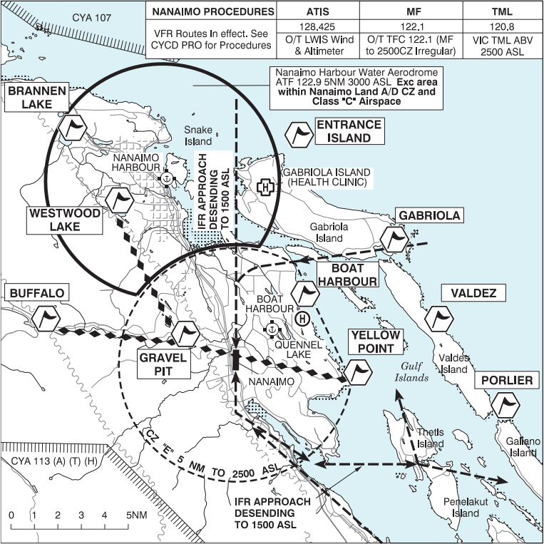
Nanaimo VFR Terminal procedures chart
Notes:
This is how the new VTPC will appear,
CYA107 Should be CYR107 will be corrected in pub or NOTAM’d

Slide 11
Nanaimo VFR Terminal procedures chart
THIS VTPC WILL BE PUBLISHED IN THE CFS, WAS AND THE NEXT VFR TERMINAL AREA CHART (AIC)
NEXT SLIDES WILL DESCRIBE:
CONTROL ZONES
IFR APPROACH ROUTES
VFR CHECKPOINTS
VFR ROUTES
Notes:
VIA Aeronautical Information Circular

Slide 12
Control Zones
NANAIMO
CONTROL ZONE DEPICTED AS 5NM IRREGULAR, CLASS E SFC-2500ASL
TOP BOXES DESCRIBE CYCD ZONE AND RADIO FREQUENCIES
NANAIMO HAROUR
ATF DEPICTED AS 5 NM WITH A COOKIE BITE
ATF FREQ 122.9 SFC-3000ASL EXCLUDING THE CYCD CZ MF AREA AND VICTORIA TERMINAL CLASS C ABV 2500 ASL
Notes:
Both CYCD CZ and Harbour ATF Area will now be displayed in all pubs

Slide 13
IFR Approaches
CURRENTLY CYCD HAS 3 PUBLISHED APPROACHES:
RNAV Y
RNAV Z
ILS
ALL 3 APPROACHES ARE FOR RWY 16 WITH A 10 NM STRAIGHT IN FINAL
Notes:
IFR Tracks will be displayed in all VFR pubs to help raise awareness

Slide 14
IFR visual Approach 16
CYCD CIRCUIT PATTERN
VISUAL APCH RWY 16 SHOULD FLY A HEADING TO THE YCD NDB AND INTERCEPT FINAL AT APRX 4 NM
4 NM FINAL AVOIDS CIRCUIT TRAFFIC AND ALSO HELPS WITH NOISE ABATEMENT
Notes:
CYCD circuit is very restricted due to irregular size and shape, as well as constraints from terrain. The circuit pattern is to the E of AD and majority of our IFR traffic also comes from the east. This places a lot of traffic with varying skill and performance in close proximity and limited options to resolve conflicts.
Eg). C172 student vs Q400/B190s flown by IFR pilots)
By tracking to the NDB it keeps IFRs outside of the circuit and allows spacing for additional traffic solutions.
Eg). Extending CCT down wind, CCT traffic gain visual and follow IFR acft, CCT traffic early base/final turn etc.

Slide 15
IFR visual Approach 34
ENTER SLANT BASE OVER LADYSMITH HARBOUR
FOLLOW HARBOUR AND SHORELINE TO FINAL
Notes:
APCH profiles vary slightly based on acft type, performance and experience but typically squared off for 1-3 NM final

Slide 16
VFR checkpoints
NEW VFR CHECKPOINTS HAVE BEEN CREATED TO HELP ESTABLISH VFR ROUTES AND REPORTING POINTS NEAR AND THROUGH THE CYCD CONTROL ZONE
PREVIOUS CHECKPOINTS AT: BUFFALO, GABRIOLA, VALDEZ AND PORLIER ARE STILL IN EFFECT
NEW CHECKPOINTS AT:
ENTRANCE ISLAND
BRANNEN LAKE
WESTWOOD LAKE
BOAT HARBOUR
YELLOW POINT
GRAVEL PIT

Slide 17
THE Gravel pit
CURRENTLY VFR AIRCRAFT OFTEN FOLLOW THE HIGHWAY INBOUND OR TO TRANSIT THE ZONE N-S
FLYING OVER GRAVEL PIT WILL CREATE LATERAL SAFE ZONE AND ESTABLISHES A STANDARD ROUTE TO JOIN THE CIRCUIT
MAP
Notes:
CLICK MAP BUTTON

Slide 18
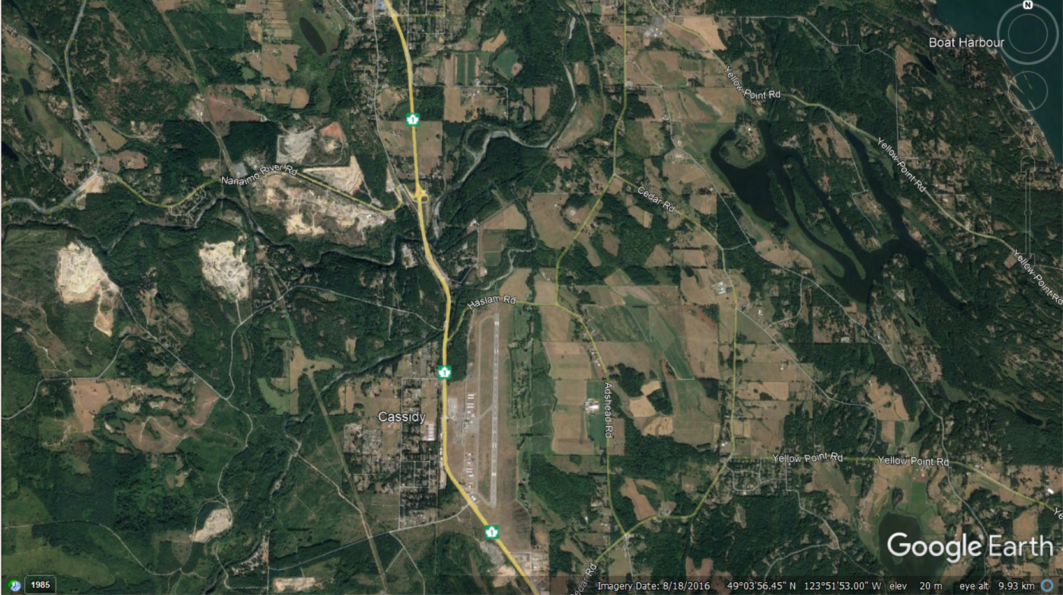
GRAVEL PIT
Notes:
VFR following highway come very close to the extended CL to the north and crosses the extended CL to the south
Flying over the gravel pit provides lateral safe zones from the critical areas of both runways for safe midfield crossing.
(2 pits, larger one to the west is the checkpoint but as long as ACFT are over/west of either pit it is okay)

Slide 19
VFR ROUTES
VFR ROUTES HAVE BEEN CREATED WITH THE NEW CHECKPOINTS
ROUTES WILL HELP KEEP IFR/VFR AIRCRAFT SEPARATED ENTERING INTO THE CIRCUIT
ESTABLISHES TRANSIT ROUTES THROUGH THE CYCD CZ.
Notes:
These routes enhance safety for all aircraft to operate in and near the Nanaimo control zone

Slide 20
Nanaimo VTPC VFR Arrivals rwy 16
ALL AIRCRAFT INBOUND FROM W-N FOLLOW VFR ROUTE FROM BUFFALO OR WESTWOOD LAKE TO GRAVEL PIT
THEN CROSS OVER MIDFIELD TO JOIN THE CIRCUIT INTO THE DOWNWIND

Slide 21
Nanaimo VTPC VFR Arrivals rwy 16
ALL AIRCRAFT INBOUND FROM NE-E USE GABRIOLA, VALDEZ OR PORLIER
JOIN THE CIRCUIT MID DOWNWIND

Slide 22
Nanaimo VTPC VFR Arrivals rwy 16
ALL AIRCRAFT INBOUND FROM SE-S FLY OVER YELLOW POINT TO JOIN THE CIRCUIT INTO MID DOWNWIND
Notes:
Why via Yellow point?
Alleviate congestion/conflicts in Ladysmith Harbour between departing aircraft climb out and descending inbounds to downwind.
Eg). High wing climb out vs low wing descent over Ladysmith Harbour.
High performance aircraft climb out head to head with slower inbounds.
LADY SID over the Harbour is relatively new and most VFR pilots are still not familiar, expecting IFR departures off RWY 16 with a left hand shuttle climb inside the zone.

Slide 23
Nanaimo VTPC VFR Arrivals rwy 34
ALL AIRCRAFT INBOUND FROM W-N FOLLOW VFR ROUTE FROM BUFFALO OR WESTWOOD LAKE TO GRAVEL PIT
THEN CROSS OVER MIDFIELD TO JOIN THE CIRCUIT INTO THE DOWNWIND

Slide 24
Nanaimo VTPC VFR Arrivals rwy 34
ALL AIRCRAFT INBOUND FROM NE-E USE GABRIOLA, VALDEZ OR PORLIER
JOIN THE CIRCUIT MID DOWNWIND

Slide 25
Nanaimo VTPC VFR Arrivals rwy 34
ALL AIRCRAFT INBOUND FROM SE-S FLY OVER THE MOUTH OF LADYSMITH HARBOUR AND FOLLOW THE HARBOUR INTO SLANT BASE TO FINAL

Slide 26
VFR ROUTES
TRANSITING THE ZONE
VFR AIRCRAFT CURRENTLY TRANSIT RANDOMLY OR FOLLOW THE HIGHWAY N-S
FOLLOWING THE HIGHWAY CROSSES THE LADY2. DEPARTURE PATH TWICE AND INCREASES CONGESTION OVER LADYSMITH HARBOUR
NEW VTPC PROCEDURES
N-S TRANSIT OVER WESTWOOD LAKE AND YELLOW POINT VIA GRAVEL PIT
Notes:
AFTER 1ST POINT-REMIND PPL OF GOOGLE EARTH IMAGE OF GRAVEL PIT WAYPOINT.
Following highway creates potential conflict with ARR/DEP path for both RWYs

Slide 27
VFR ROUTES
TRANSITING THE ZONE
VFR AIRCRAFT CURRENTLY TRANSIT RANDOMLY OR FOLLOW THE HIGHWAY N-S
FOLLOWING THE HIGHWAY CROSSES THE LADY2. DEPARTURE PATH TWICE AND INCREASES CONGESTION OVER LADYSMITH HARBOUR
NEW VTPC PROCEDURES
N-S TRANSIT OVER WESTWOOD LAKE AND YELLOW POINT VIA GRAVEL PIT
E-W TRANSIT OVER BUFFALO AND YELLOW POINT VIA GRAVEL PIT
AIRCRAFT ARE EXPECTED TO TRANSIT AT 2500 FT
Notes:
New Procedure Avoids circuit traffic and both ARR/DEP paths.
Establishes easy link to VTA TML VFR route, where terminal will normally direct VFR aircraft that they are talking to.
VFRs Transit at 2500 ft will be above circuit traffic and below IFR SIDs 3000 ft.

Slide 28
Questions?
THE END

